Slide 1
An In-Depth Study of Tiny Object Detection Using Deep Learning Approach
Deep learning and intelligent image analysis
答辩人： Rahman Md Mahbubur (Saikat)
时间：2024/5/24

Slide 2
目录
1
Introduction
2
Introduction to Yolo
CONTENTS
3
Inference with SAHI

Slide 3
Introduction
1
Objective:
To create an effective object detection model using YOLOv5 & YOLOv8
To enhance detection performance with SAHI (Slicing Aided Hyper Inference)
Scope:
Overview of YOLOv5 and SAHI & YOLOv8
Training and inference processes
Results and performance metrics

Slide 4
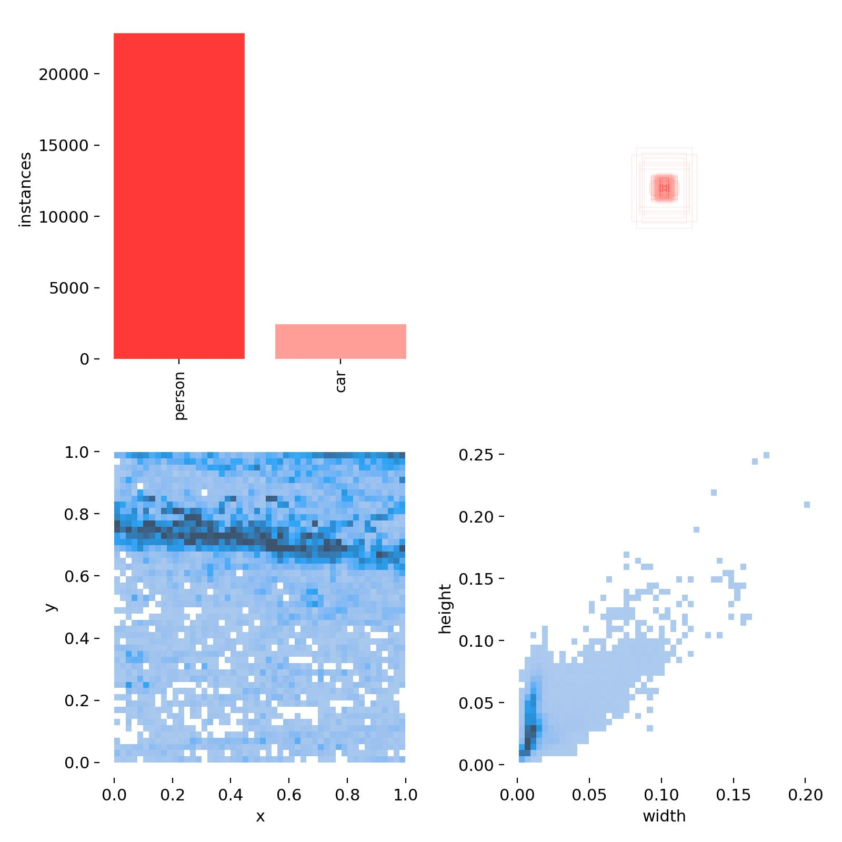
Background on Object Detection
1
Definition and Challenges
Definition:
What is object detection?
Importance in various applications (e.g., surveillance, autonomous driving, etc.)
Common Challenges:
Small object detection
Occlusions
Computational constraints
Imbalance Classes

Slide 5
2
Yolov5 & Yolov8 Implementation

Slide 6
Introduction to Yolo
1
Overview
Advantages
YOLO uses a single convolutional neural network to divide an image into grids and predicts bounding boxes and class probabilities for each grid cell.
This end-to-end approach allows for real-time object detection with high accuracy, making it efficient for applications requiring quick and reliable object recognition.
YOLOv5 & Yolov8 both excels in speed and accuracy, offering real-time processing capabilities.
YOLOv5 is efficient architecture enables rapid object detection, making it ideal for applications where both quick response and precision are crucial while Yolov8 improved inference speed.

Slide 7
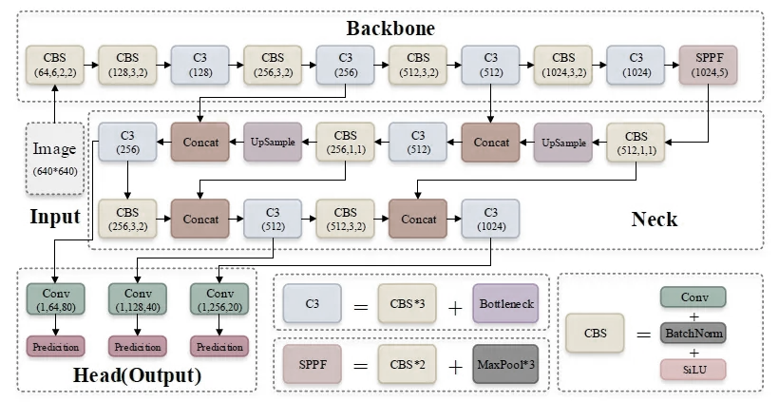
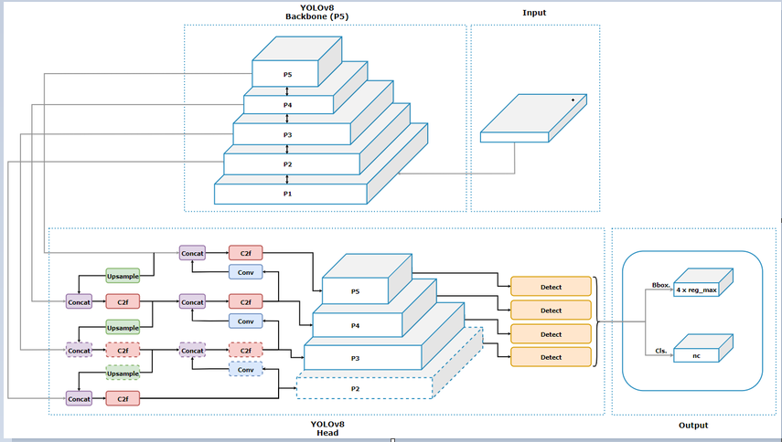
2
YOLO Architectures highlight & Software Tools
Parameters | Yolov8 | Yolov5
Parameters | nc: 6 depth_multiple: 0.33 width_multiple: 0.50 | nc: 6 depth_multiple: 0.33 width_multiple: 0.25
Anchors | P3/8: [10,13, 16,30, 33,23] P4/16: [30,61, 62,45, 59,119] P5/32: [116,90, 156,198, 373,326] | --
Backbone | - Focus, Conv, and C3 layers with varying parameters | - Conv and C2f layers with varying parameters
Head | - Conv, nn.Upsample, and Concat layers with varying parameters | - Conv, nn.Upsample, and Concat layers with varying parameters
Figure 4 overview of Yolov5 Model Architecture.
Figure 5 overview of Yolov8 Model Architecture.

Slide 8
Data Processing
2
Splitting Ratio (Train, Valid, Test)
Handling Missing Values (corrupt image/label)
Data Augmentations (flipping, scaling, cropping)
Notes:
Data Split: Train=85% and Validate15%
Data Issues: rgb_0068_00000001.jpg: ignoring corrupt image/label: non-normalized or out of bounds coordinates [1.0005]
Augmentation:
1. Albumentations
2. Hyperparameters for low, medium, and high-augmentation COCO training from scratch

Slide 9
Objective and Techniques
2
Exp 1
Exp 2
Objective: The goal is to improve detection accuracy, especially for small objects, and to optimize the model's efficiency by customized Yolo.
Hyp Tuning
Techniques: Train 405 imgs (85%) and Valid 71 imgs (15%); Freezing Layer 0,1, Custom hyp, Adam Optimizer, AutoAnchor, yolov5s.pt, yolov8n.pt, yolov8s.pt etc.
Techniques: Train 405 imgs (85%) and Valid 71 imgs (15%); Albumentations, AutoAnchor, yolov5s.pt, yolov8n.pt, yolov8s.pt etc.
Objective: To establish a baseline performance using default YOLOv5 & YOLOv8 settings.
Techniques: Train 405 imgs (85%) and Valid 71 imgs (15%); We have used Automate Hyper parameter to get the ideas of it. We run 10 epochs with 100 iterations. (Time Consuming)
Objective: The goal is to leverage these techniques to realize the hyper parameters setup.

Slide 10
Yolov5 Hyper Parameters Tuning
Yolov5 hyper parameter tuning for each model
300 epochs
Batch 16
Inference
Img 640
Feature | Exp.: 1 (default) | Exp.: 2 (custom)
Model | YOLOv8s | YOLOv8s
Epochs | 300 | 300
Image Size (imgsz) | 640 | 640
Batch Size (batch) | 16 | 32
Optimizer | SGD | AdamW
Hyper-parameters | Default | lr0: 0.00258; lrf: 0.17; momentum: 0.779; weight_decay: 0.00058; warmup_epochs: 1.33; warmup_momentum: 0.86; warmup_bias_lr: 0.0711; box: 0.0539; cls: 0.299; cls_pw: 0.825; obj: 0.632; obj_pw: 1.0; iou_t: 0.2; anchor_t: 3.44; anchors: 3.2; fl_gamma: 0.0; hsv_h: 0.0188; hsv_s: 0.704; hsv_v: 0.36; degrees: 0.0; translate: 0.0902; scale: 0.491; shear: 0.0; perspective: 0.0; flipud: 0.0; fliplr: 0.5; mosaic: 1.0

Slide 11
Yolov8 Hyper Parameters Tuning
Yolov8 hyper parameter tuning for each model
Feature | Exp.: 1 (default) | Exp.: 2 (custom) | Exp.: 3 (default) | Exp.: 4 (custom)
Model | YOLOv8n | YOLOv8n | YOLOv8s | YOLOv8s
Epochs | 300 | 300 | 300 | 300
Image Size (imgsz) | 640 | 640 | 640 | 640
Batch Size (batch) | 16 | 32 | 16 | 32
Freeze | -- | [0] (Freeze First Layer) | -- | [0] (Freeze First Layer]
Dropout | -- | 0.1 | -- | 0.1
Optimizer | AdamW | SGD | AdamW | SGD
Hyper-parameters | Default | lr0=0.00938, lrf=0.00875, momentum=0.93099, weight_decay=0.00057, warmup_epochs=3.0, warmup_momentum=0.75579, box=7.02336, cls=0.44188, dfl=1.40956, hsv_h=0.0154, hsv_s=0.73327, hsv_v=0.36094, degrees=0.0, translate=0.09004, scale=0.5, shear=0.0, perspective=0.0, flipud=0.0, fliplr=0.48808, bgr=0.0, mosaic=1.0, mixup=0.0, copy_paste=0.0 | Default | lr0=0.00933, lrf=0.0102, momentum=0.938, weight_decay=0.0005, warmup_epochs=3.05, warmup_momentum=0.85, box=7.6, cls=0.55, dfl=1.5, hsv_h=0.017, hsv_s=0.69, hsv_v=0.45, degrees=0.0, translate=0.10, pose=12.5, kobj=1.1, scale=0.55, shear=0.0,perspective=0.0, flipud=0.0, fliplr=0.55, bgr=0.0, mosaic=1.0, mixup=0.0,copy_paste=0.0

Slide 12
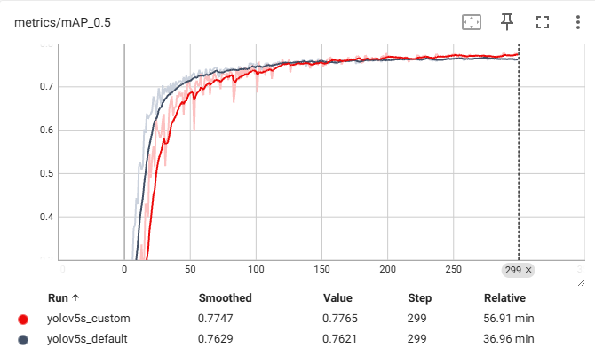
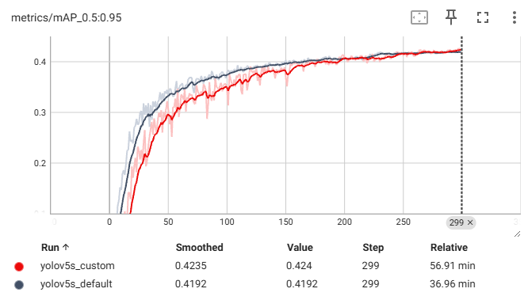
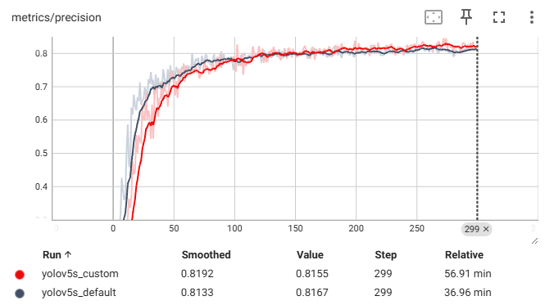
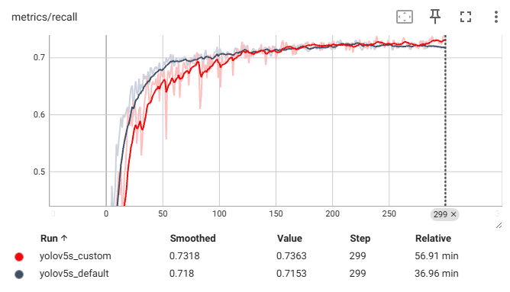
Training Metrics Comparison(Yolov5)
2
Figure 3 Training Matrices Comparison between default and custom Models

Slide 13
Evaluation and Result Analysis (Yolov5)
2
Evaluation Result on Training Dataset
Exp1 (Models) | Avg. Recall | Avg. Miss Rate | Avg. False Positive Rate | Avg. Precision | Avg. Accuracy | Number of Test Images
Yolov5s_default | 0.8341 | 0.1658 | 0.0041 | 0.9890 | 0.8336 | 477
Yolov5s_custom | 0.8486 | 0.1513 | 0.0125 | 0.9923 | 0.8475 | 477
Evaluation Result on Test Dataset
Exp1 (Models) | Avg. Recall | Avg. Miss Rate | Avg. False Positive Rate | Avg. Precision | Avg. Accuracy | Number of Test Images
Yolov5s_default | 0.5318 | 0.4681 | 0.0465 | 0.8333 | 0.5316 | 43
Yolov5s_custom | 0.5783 | 0.4216 | 0.0465 | 0.8798 | 0.57811 | 43

Slide 14
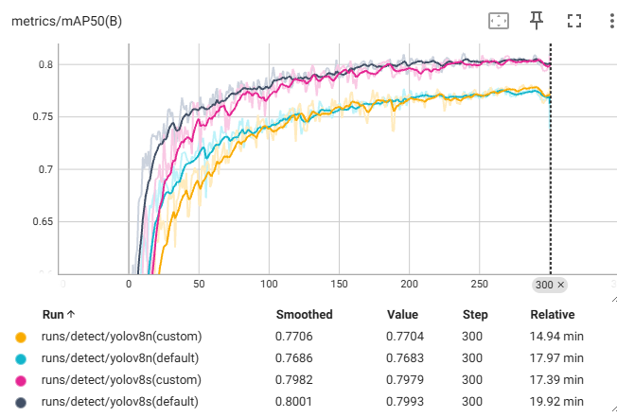
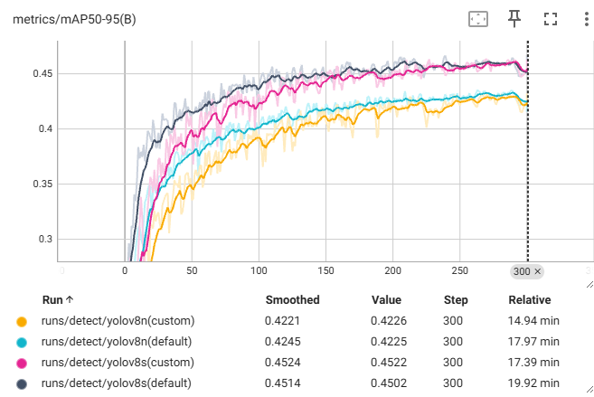
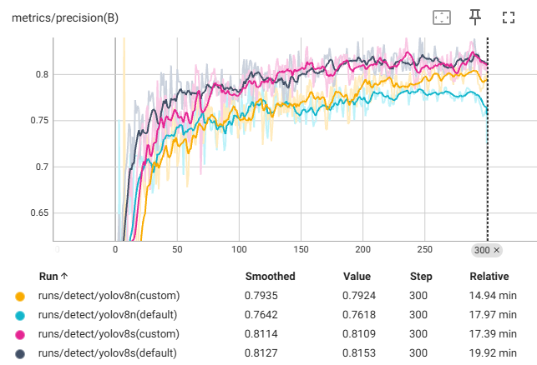
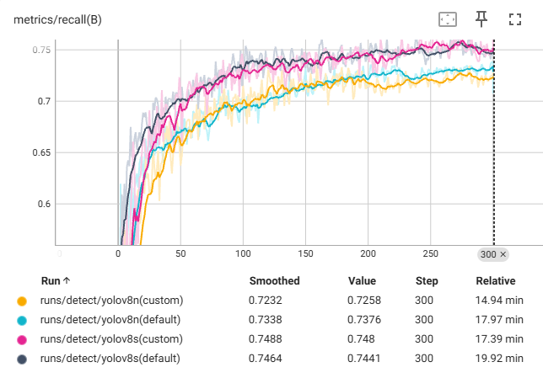
Training Metrics Comparison(Yolov8)
2
All Yolov8 models matrices after training 300 epochs

Slide 15
Evaluation and Result Analysis (Yolov8)
2
Evaluation Result on Training Dataset
Experiment (Models) | Avg. Recall | Avg. Miss Rate | Avg. False Positive Rate | Avg. Precision | Avg. Accuracy | Number of Test Images
yolov8s(default) | 0.8189 | 0.1811 | 0.0000 | 0.9895 | 0.8189 | 477
yolov8n(default) | 0.7946 | 0.2054 | 0.0021 | 0.9852 | 0.7945 | 477
yolov8s(custom) | 0.8237 | 0.1763 | 0.0042 | 0.9893 | 0.8235 | 477
yolov8n(custom) | 0.7944 | 0.2056 | 0.0021 | 0.9831 | 0.7943 | 477
Evaluation Result on Training Dataset
Experiment (Models) | Avg. Recall | Avg. Miss Rate | Avg. False Positive Rate | Avg. Precision | Avg. Accuracy | Number of Test Images
yolov8s(default) | 0.5265 | 0.4734 | 0.0232 | 0.7906 | 0.5265 | 43
yolov8n(default) | 0.5213 | 0.4786 | 0.0232 | 0.7906 | 0.5213 | 43
yolov8s(custom) | 0.5788 | 0.4211 | 0.0000 | 0.83720 | 0.5788 | 43
yolov8n(custom) | 0.5098 | 0.4901 | 0.0232 | 0.74160 | 0.50724 | 43

Slide 16
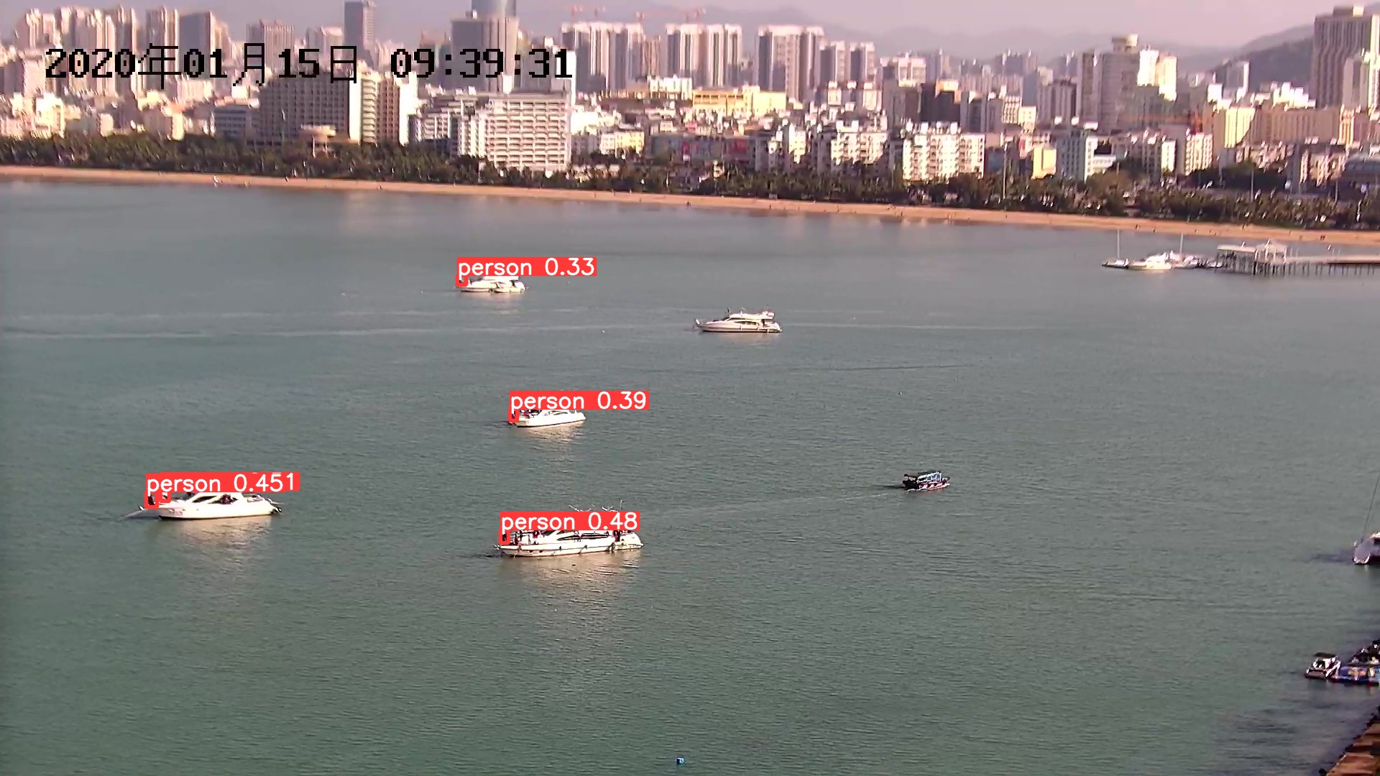
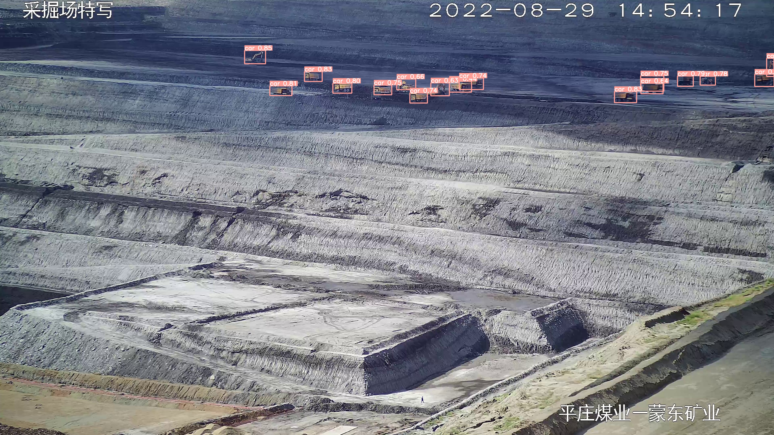
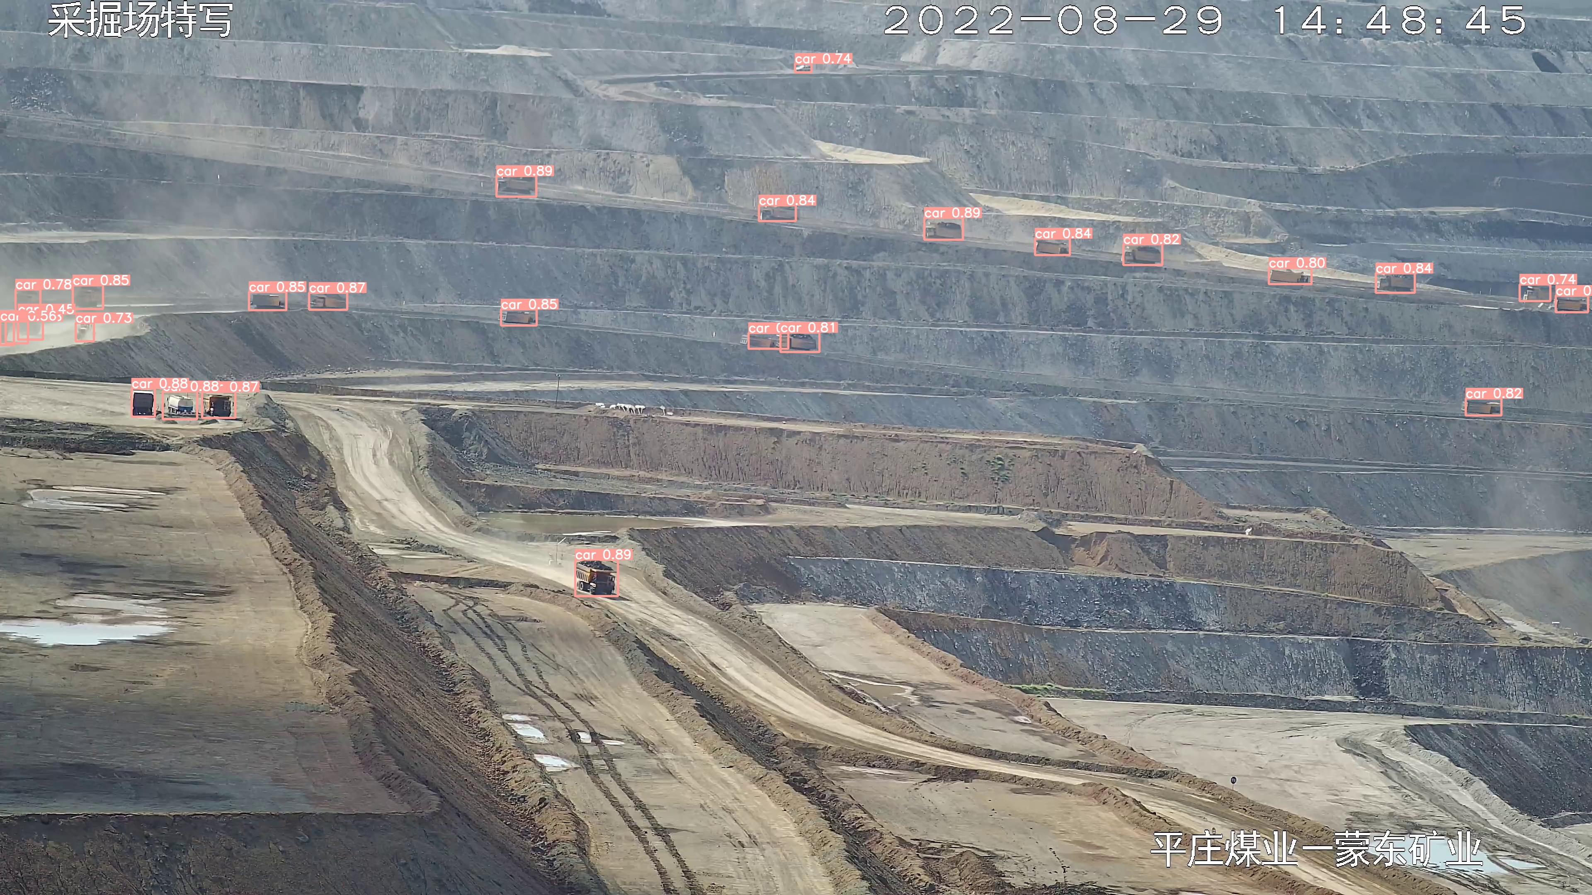
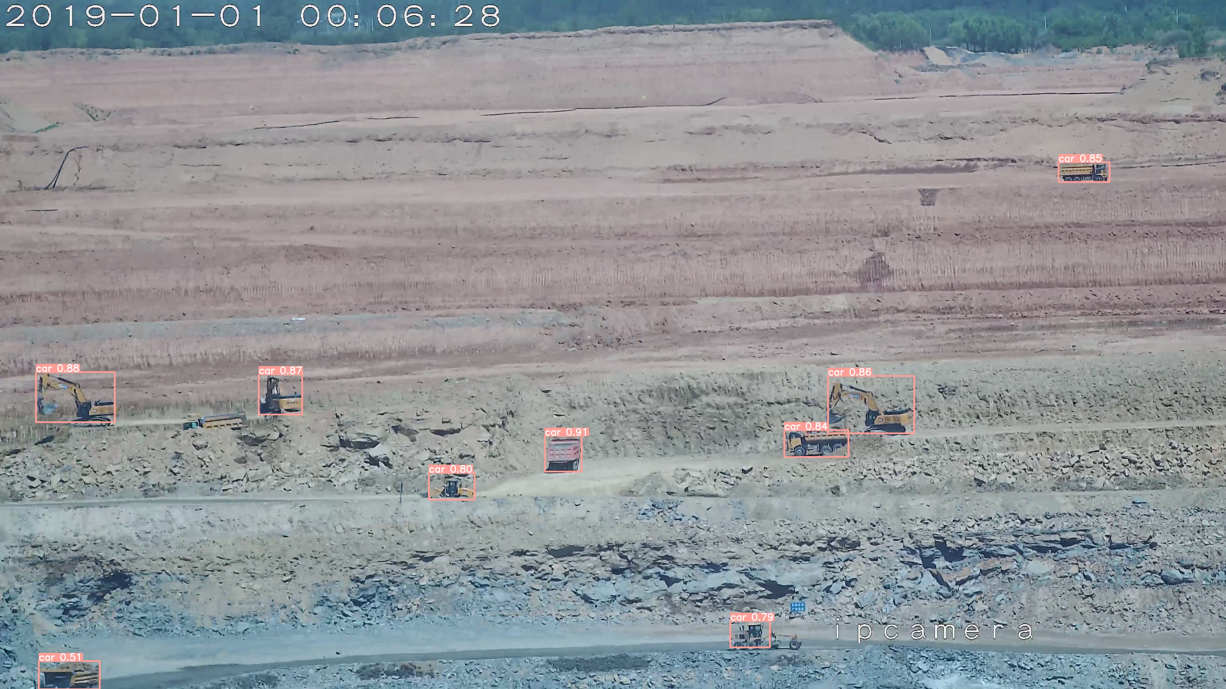
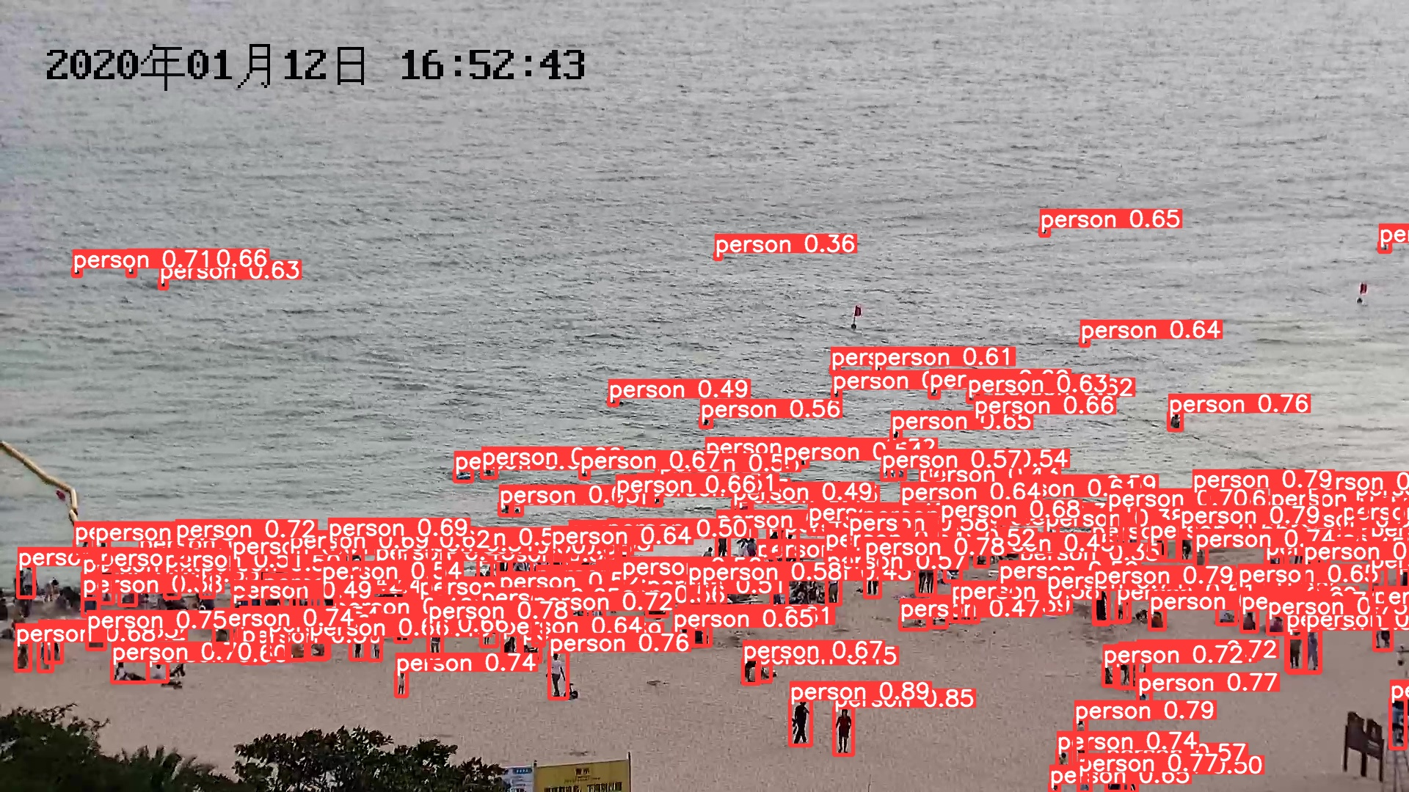
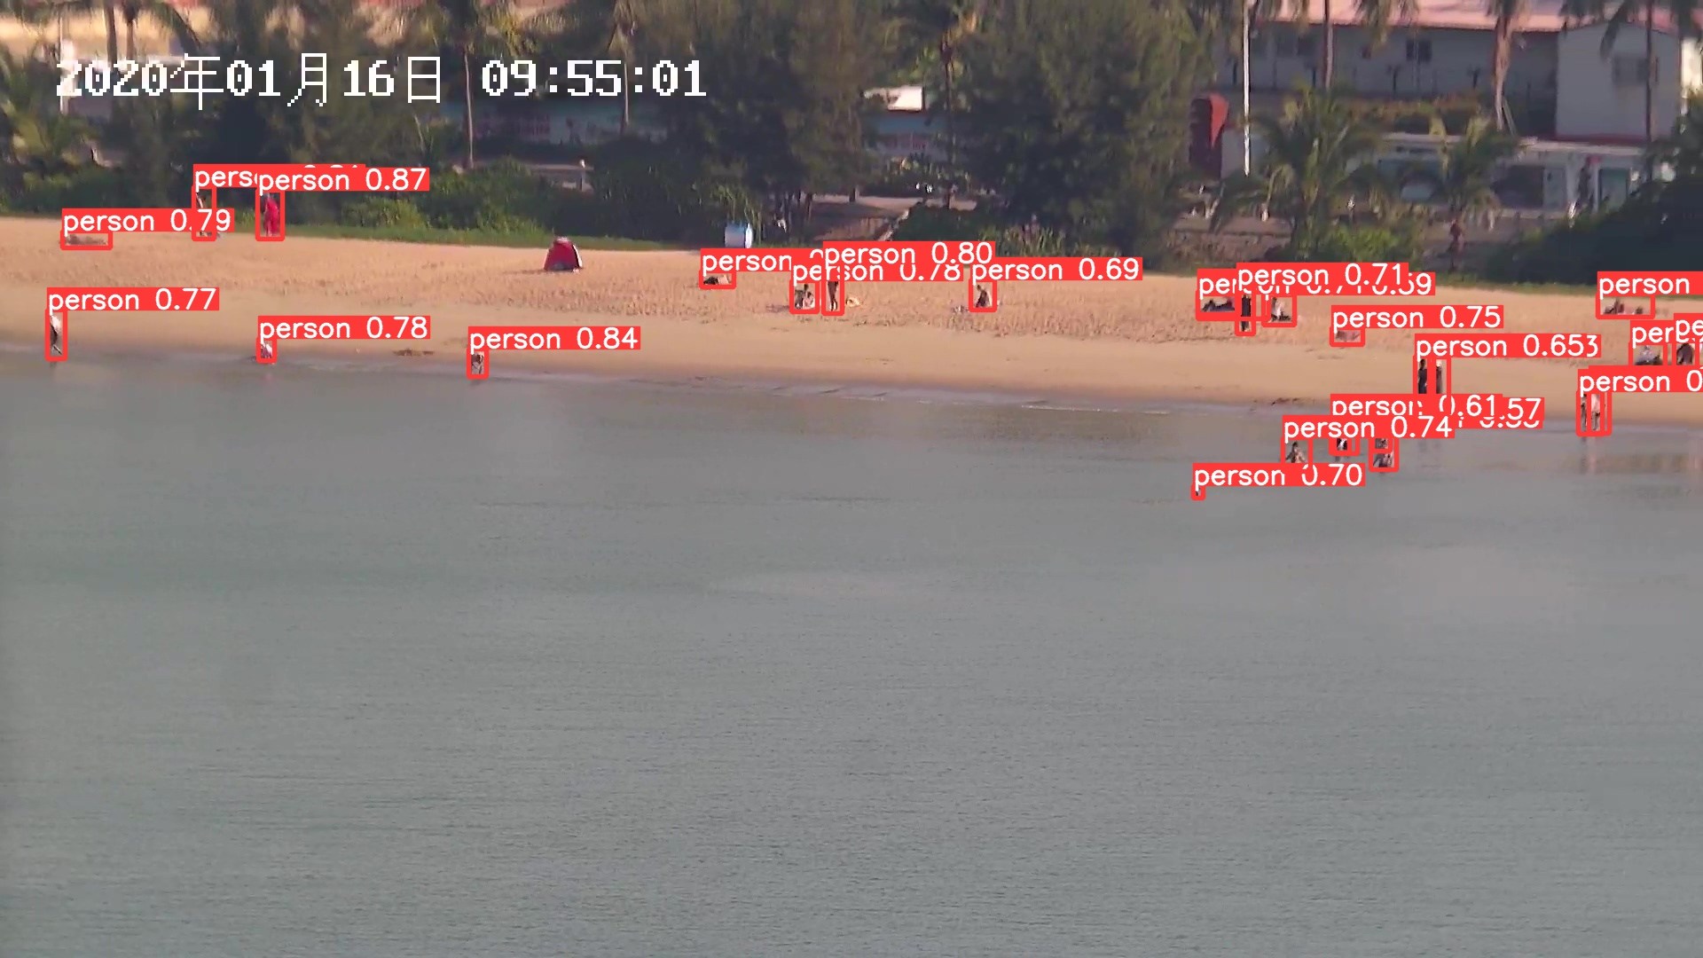
Detected by Pre-trained weight
2
Object detection by pre-trained weight after running 300 epochs

Slide 17
3
Inference with SAHI

Slide 18
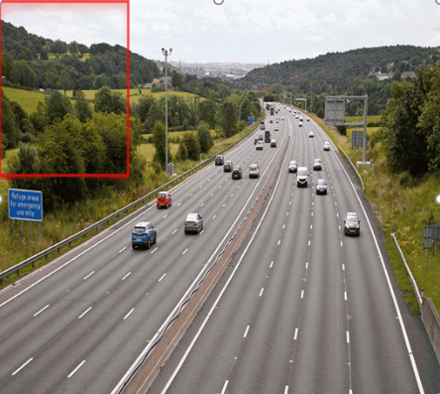
Idea of SAHI in Object Detection
SAHI (Slicing Aided Hyper Inference) enhances object detection by slicing input images into smaller, overlapping patches. Each patch is processed individually by the detection model, which allows for better identification of small and densely packed objects.
The results from these patches are then merged to produce the final detection output, improving overall performance and accuracy. This approach ensures that even small objects, which might be missed in a full-scale image, are detected accurately.

Slide 19
Integrating SAHI
Steps
Modifying inference pipeline to include SAHI
Configuration of slicing parameters (e.g., slice size, overlap ratio)
Advantages:
Improved performance on small objects
model_type = "yolov5"
model_path = yolov5_model_path
model_device = "0" # or 'cpu'
model_confidence_threshold = 0.3
slice_height = 512
slice_width = 512
overlap_height_ratio = 0.2
overlap_width_ratio = 0.2

Slide 20
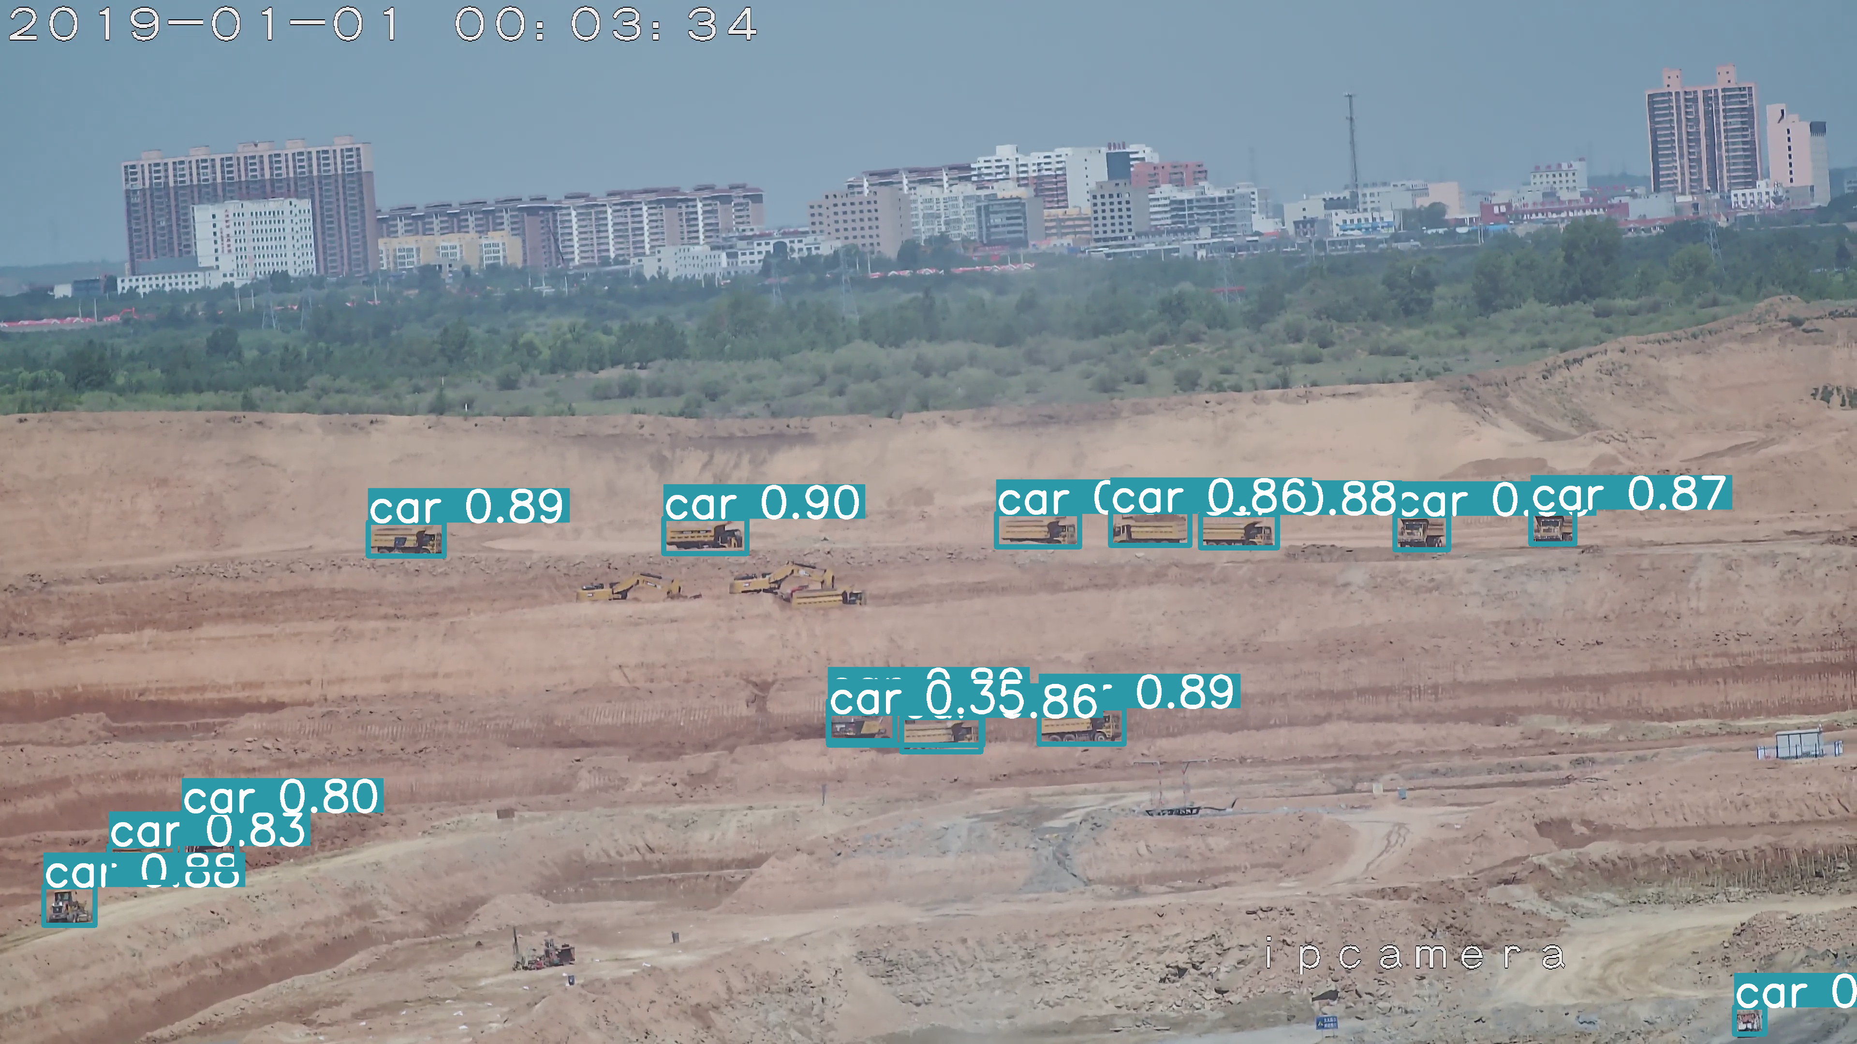
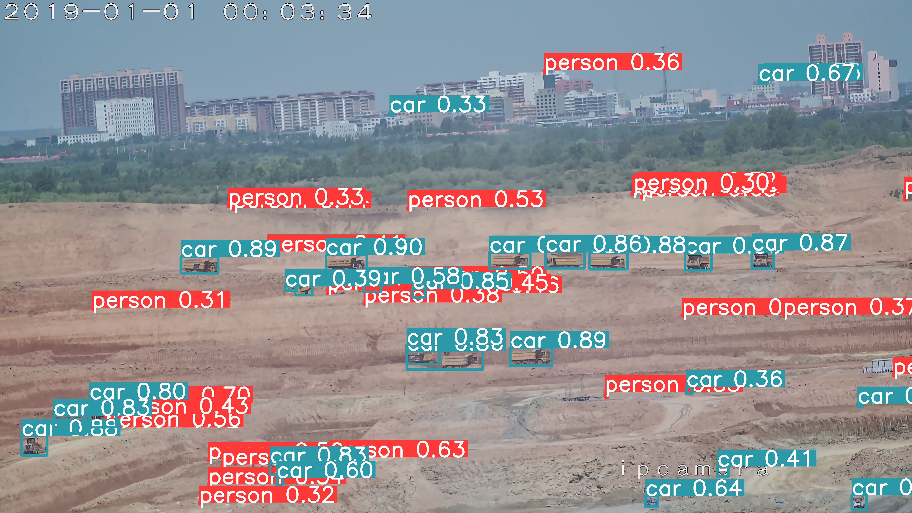
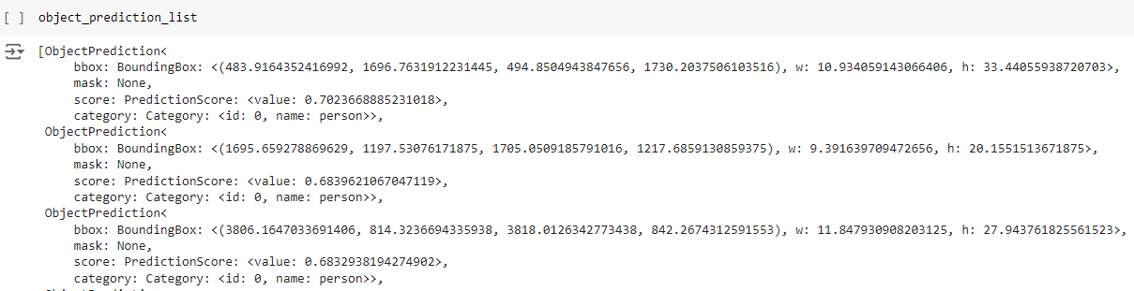
Comparison of YOLO and SAHI
Before using SAHI
After using SAHI

Slide 21
Thanks

